Slide 1
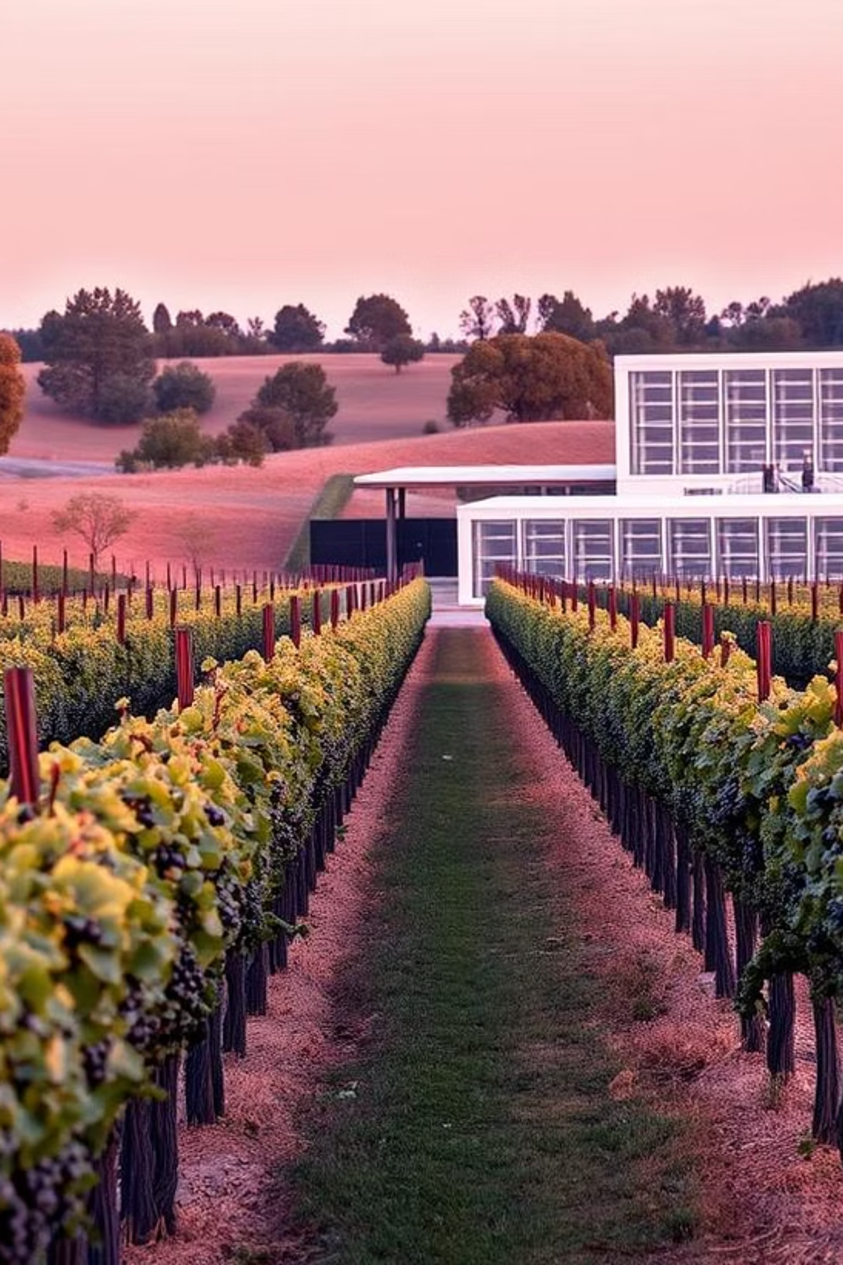
Wine Quality Prediction using Machine Learning with Python
Bridging winemaking artistry with cutting-edge data science to revolutionise quality assessment, with Python as our pivotal tool for model development.

Slide 2
The Challenge of Wine Quality Assessment
Subjectivity & Cost
Inconsistency & Losses
Traditional sensory panels are subjective, costly (£500-£1,500 per session), and time-consuming, delaying feedback by weeks.
Human bias leads to up to 30% inter-assessor variability, potentially causing £15-£20M in annual losses for large wineries due to inconsistent product quality.

Slide 3
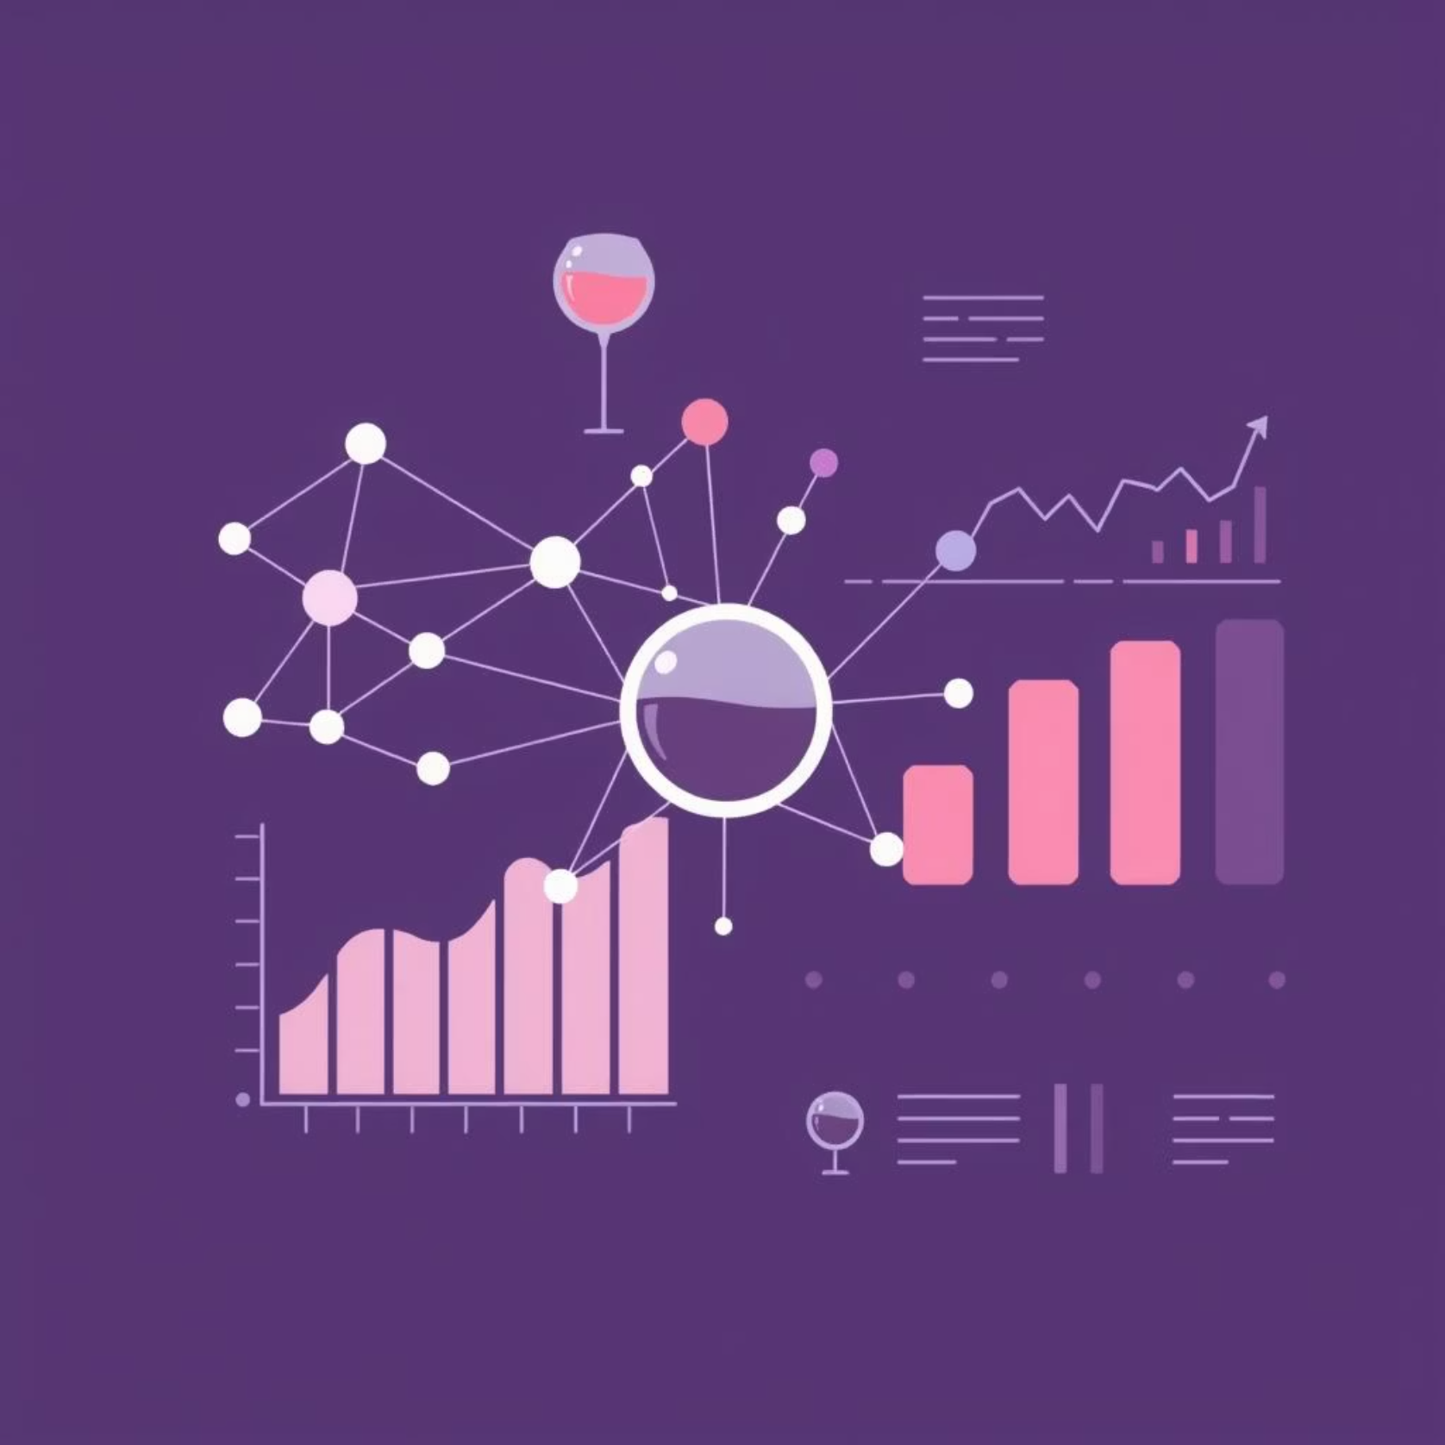
Introducing Machine Learning for Objective Quality
Our solution develops predictive models from physicochemical data, offering real-time, consistent, and cost-effective (up to 80% reduction) quality assessment.
The goal is to predict wine 'quality' (0-10 scale) or 'good/bad' classification by leveraging complex relationships beyond human perception.

Slide 4




Data Acquisition & Preprocessing
Primary Dataset
Physicochemical Inputs
UCI Wine Quality Dataset, including 1,599 red and 4,898 white wine samples.
11 attributes like fixed acidity, volatile acidity, pH, and alcohol content.
Preprocessing Steps
Python Tools
The dataset is being preprocessed by separating the input features (X) from the target label (Y), where the wine quality is converted into a binary classification
`pandas` for data manipulation and `numpy` for numerical operations ensure efficient data handling.

Slide 5
Feature Engineering & Selection
Alcohol Content
1
Highly correlated (+0.47) with quality.
Sulphates
2
Positive impact (+0.25) on quality scores.
Volatile Acidity
3
Strong negative correlation (-0.39) with quality.
Correlation Analysis
4
Techniques like correlation matrices and tree-based model importance identify key features.

Slide 6



Machine Learning Models & Training
Target Variable
Selected Models
Data Split
Wine 'quality' (integer 0-10), binned for classification tasks.
Random Forest for robustness
80% for training and 20% for testing, using `train_test_split` from `sklearn.model_selection`.

Slide 7
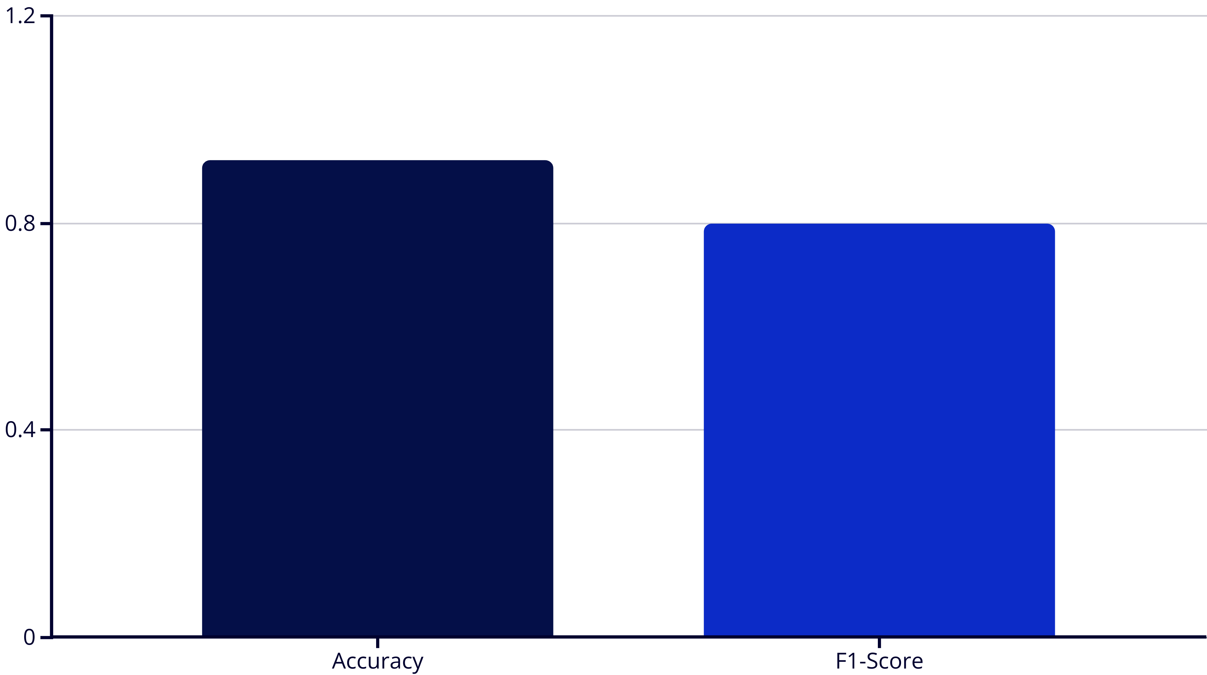
Model Evaluation and Performance
For classification, we achieved 92-93% accuracy and an F1-Score of 0.80 .We use `sklearn.metrics` for evaluation and `matplotlib` for visualising confusion matrices and residual plots.
For classification, we achieved 92-93% accuracy and an F1-Score of 0.80 .We use `sklearn.metrics` for evaluation and `matplotlib` for visualising confusion matrices and residual plots.

Slide 8
Real-world Implementation & Impact
Optimised Blending
Consistent Product
Winemakers can make informed decisions, potentially reducing waste by 10-15%.
Ensures uniformity for distributors, leading to reduced returns by 5-8%.
Consumer Confidence
Future Proactive Control
Reliable quality and taste profiles enhance consumer trust and satisfaction.
Integration with IoT sensors in vineyards enables real-time quality monitoring.
Models can be deployed via Flask API or Streamlit dashboards, providing real-time feedback.

Slide 9
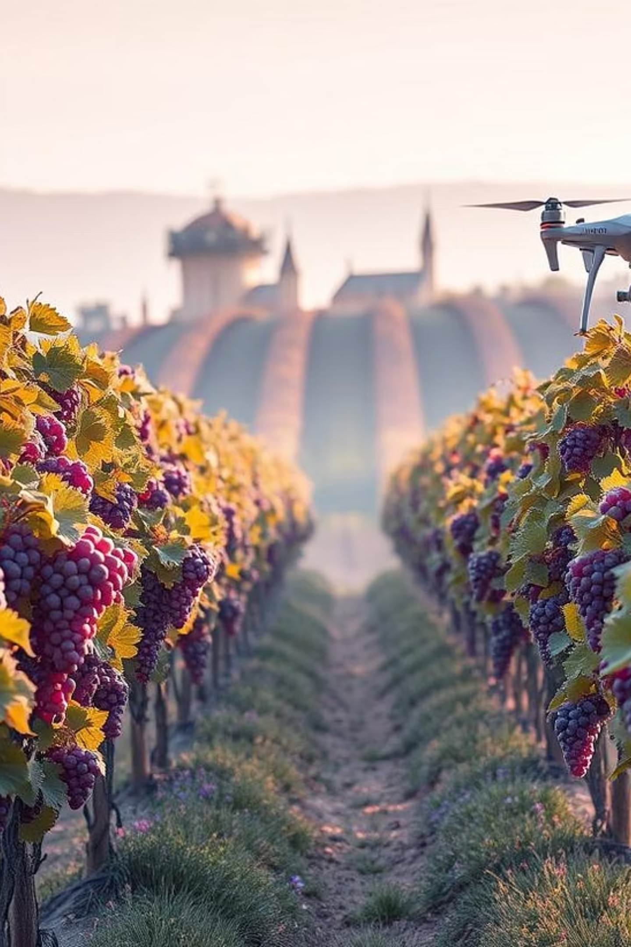
Conclusion & Future Directions
Machine learning provides objective, efficient wine quality prediction, demonstrating high accuracy and practical applicability.
Our future work includes:
Incorporating sensory panel data, weather, and soil conditions for richer datasets.
Exploring advanced deep learning models like CNNs for image-based quality assessment.
Implementing Explainable AI (XAI) for deeper insights into model decisions.
Developing real-time predictive analytics for vineyard and cellar management.

